Slide 1
Automated MazeBot Project
By Annabelle Moten
For my third year project, I decided to design & build an automated maze runner robot. The MazeBot is capable of autonomously solving a maze, as well as mapping the path on the PC in real-time. This is done with the use of a 5-Infrared sensor array along with line following code which takes into account all the possible maze instances. Furthermore, it utilizes the Left Hand Rule to avoid looping infinity around. Finally, this specific prototype will only function as expected if connected to the PC via serial-to-USB connection

Slide 2
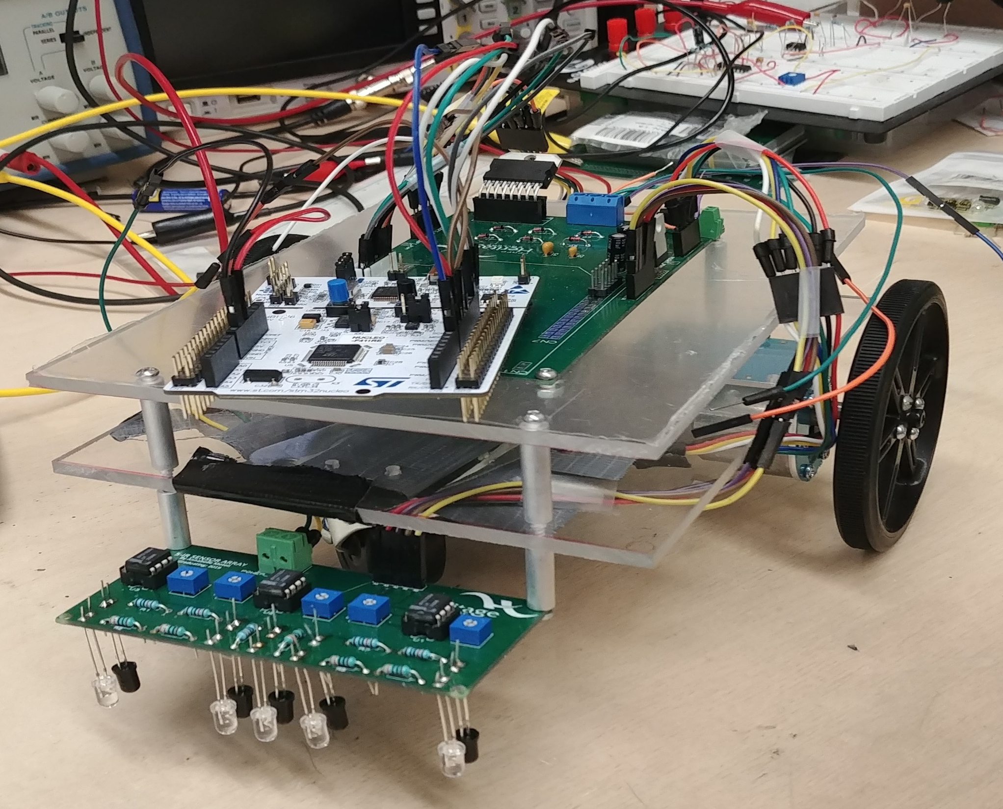

Slide 3
